Slide 1
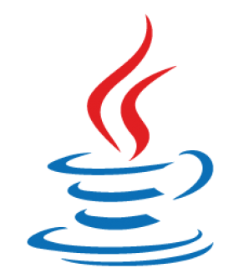
Java Architecture (JDK, JRE and JVM)
-Mohd Ansar Bux.

Slide 2
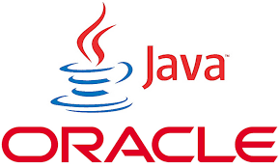
Agenda/Outline
Introduction about Java Architecture.
What is JDK?
JDK Components.
What is JRE?
JRE Components.
What is JVM?
JVM Components.
What is JIT?
Conclusion.
Q & A.

Slide 3
Introduction About Java Architecture
Java Architecture is a collection of components, i.e., JVM, JRE, and JDK.
It integrates the process of interpretation and compilation.
It defines all the processes involved in creating a Java program.
Java Architecture explains each and every step of how a program is compiled and executed.

Slide 4
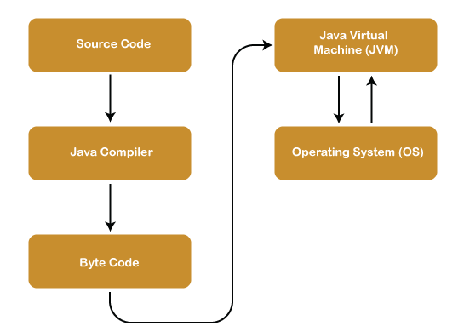
Java Architecture can be explained by using the following steps:
There is a process of compilation and interpretation in Java.
Java compiler converts the Java code into byte code.
After that, the JVM converts the byte code into machine code.
The machine code is then executed by the machine.

Slide 5
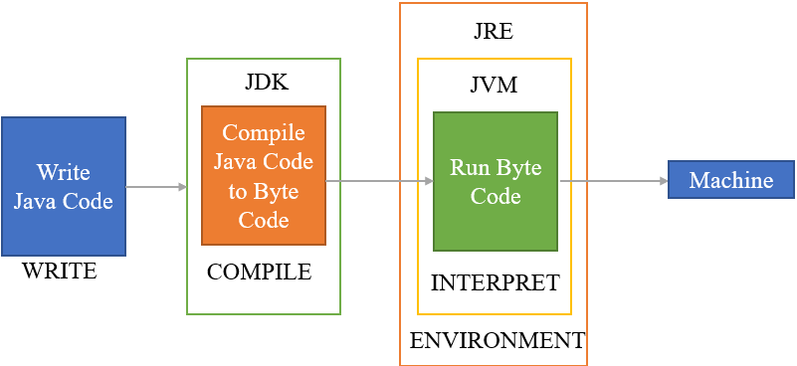
Components Of Java Architecture
The Java architecture includes the three main components:
Java Virtual Machine (JVM)
Java Runtime Environment (JRE)
Java Development Kit (JDK)

Slide 6
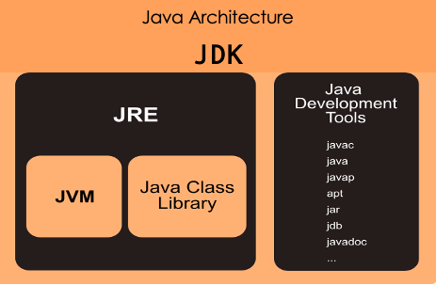
What is JDK ?
JDK is stands for Java Development Kit.
The Java Development Kit (JDK) is a software development environment provided by Oracle Corporation to develop java based applications.
It physically exists.
Java Development Kit holds JRE, a compiler, an interpreter or it include all the necessary tools and libraries, loader, and several development tools in it.

Slide 7
Components of JDK
java: This tool is an interpreter and can interpret the class files generated by the javac compiler.
javac: It specifies the Java compiler, which converts source code into Java bytecode.
javadoc: The documentation generator, which automatically generates documentation from source code comments
jar: The specifies the archiver, which packages related class libraries into a single JAR file.
javafxpackager: It is a tool to package and sign JavaFX applications.
jdb: The debugger.
extcheck: it is a utility that detects JAR file conflicts.
etc…

Slide 8
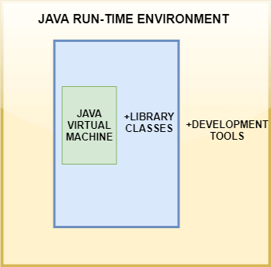
What is JRE ?
JRE is stands for Java Runtime Environment.
Java Run-time Environment (JRE) is the part of the Java Development Kit (JDK).
JRE takes our Java code, integrates it with the required libraries, and converted to Java bytecode (.class) file.
If you wish to run this bytecode on any platform like Windows, Linux, MacOS you require JRE.
It is a freely available software distribution which has Java Class Libraries such as Lang and util., specific tools, and a stand-alone JVM.

Slide 9
Components Of JRE
Deployment technologies such as deployment, Java plug-in, and Java Web Start.
User interface toolkits, including Abstract Window Toolkit (AWT), etc.
Integration libraries including Interface Definition Language (IDL), Java Database Connectivity (JDBC), etc.
Lang and util base libraries, including lang and util, zip, Java Archive (JAR), instrument, reflection, Collections, etc.
Java Virtual Machine (JVM), the main feature of Java is WORA. WORA stands for Write Once Run Anywhere.

Slide 10
What is JVM ?
JVM is stands for Java Virtual Machine.
The main feature of Java is WORA. WORA stands for Write Once Run Anywhere.
Our Java program can run any of the platforms only because of the Java Virtual Machine.
JVM's main task is to convert byte code into machine code.
JVM, first of all, loads the code into memory and verifies it. After that, it executes the code and provides a runtime environment.
Java Virtual Machine has its own architecture

Slide 11
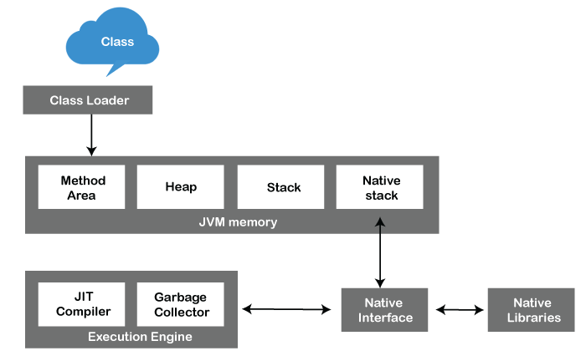
Components Of JVM
Class Loader.
JVM memory.
Execution Engine.
Native Interface.
Native Libraries.

Slide 12
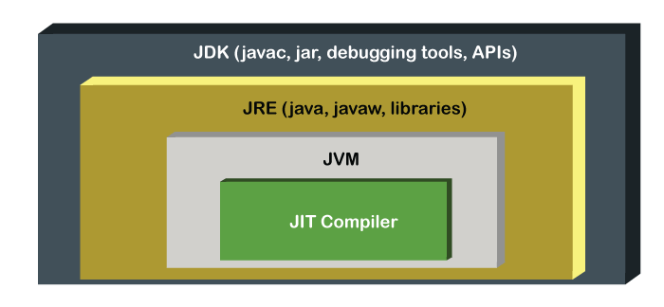
What is JIT ?
JIT is stands for Just-In-time Compiler.
Just-In-Time Compiler or JIT is a part of JVM that optimizes the performance of the application.
The JIT compilation is also known as dynamic compilation.
It optimizes the performance of the Java application at compile or run time.

Slide 13
Conclusion
Java Architecture is a versatile platform for developing and running Java based applications.
It revolves around the Java Virtual Machine (JVM), which enables platform independence by executing compiled Java bytecode/ (.class) files which is generated by Java Run-time Environment (JRE).
The architecture includes the Java Development Kit (JDK), providing developers with the necessary tools, libraries, and APIs to create, compile, and debug Java programs.
Overall, Java Architecture offers a solid foundation for building reliable and cross-platform applications that can run seamlessly across different systems.

Slide 14
Q & A
If anybody want’s to ask anything about Java Architecture please feel free to ask me.

Slide 15
Thank you
-Mohd Ansar Bux.

